Slide 1
What’s for breakfast?
Let’s examine the sugar content of our cereals...

Slide 2
The best start, every day
Whatever your choice for breakfast, it's important to maintain a regular meal pattern and try to make time to eat breakfast each morning.
This will give you a great head start on your day, providing you with the fuel needed to set about your daily tasks

Slide 3
Weetabix
4.2g of sugar per 100g

Slide 4
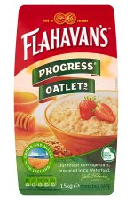
Porridge
1.6g of sugar per 100g

Slide 5
Cornflakes
10g of sugar per 100g

Slide 6
Coco-Pops
39g of sugar per 100g

Slide 7
Rice Krispies
10g of sugar per 100g

Slide 8
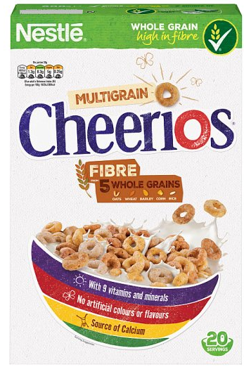
Cheerios
20g of sugar per 100g

